Slide 1
Web-based interactive visualization
Zengxiang
Feb 18th 2021
@ West Lafayette, IN

Slide 2

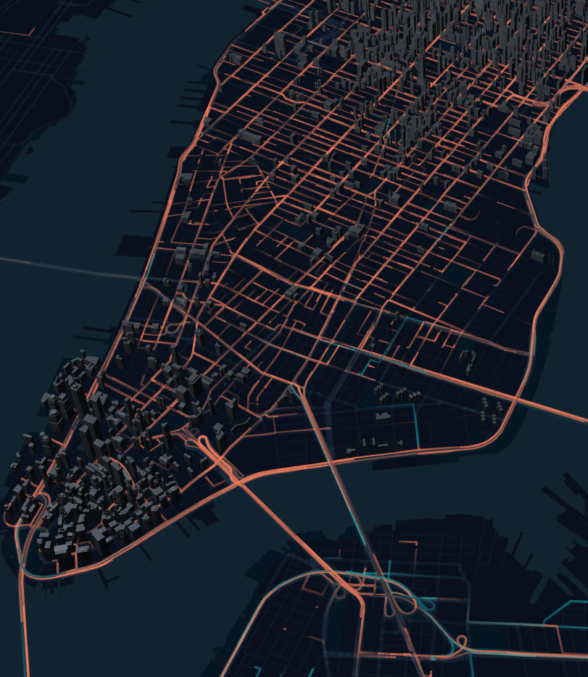
Deck.gl
Deck.gl is a WebGL-powered framework for visual exploratory data analysis of large datasets powered by Uber.
To use Deck.gl:
Import a layer from deck.gl package.
Call the Layer using JSX.

Slide 3
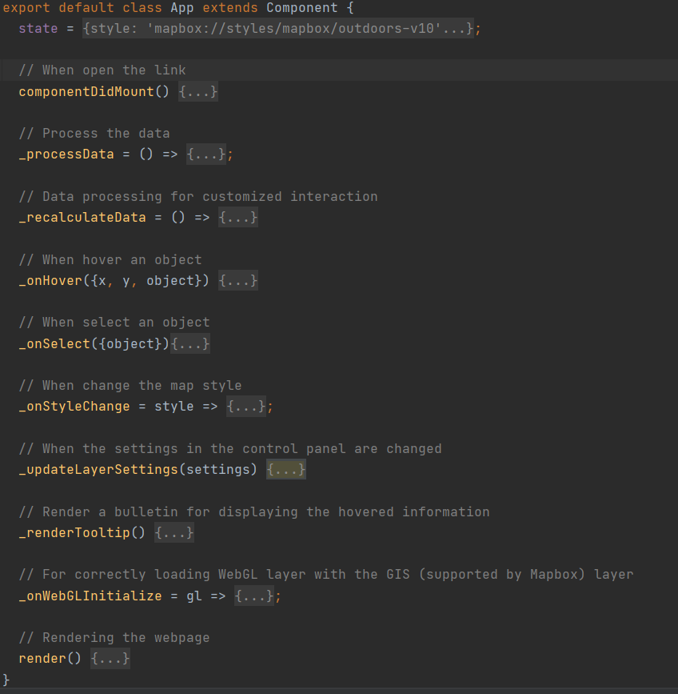
Template
Code snippet

Slide 4
Layers supported by Deck.gl
Core Layers
ArcLayer
BitmapLayer
ColumnLayer
GeoJsonLayer
GridCellLayer
IconLayer
LineLayer
PathLayer
PointCloudLayer
ScatterplotLayer
SolidPolygonLayer
TextLayer
Aggregation Layers
ContourLayer
GridLayer
GPUGridLayer
HexagonLayer
ScreenGridLayer
HeatmapLayer
Geo Layers
GreatCircleLayer
H3ClusterLayer
H3HexagonLayer
S2Layer
TileLayer
TripsLayer
TerrainLayer
MVTLayer
Mesh Layers
SimpleMeshLayer
ScenegraphLayer

Slide 5
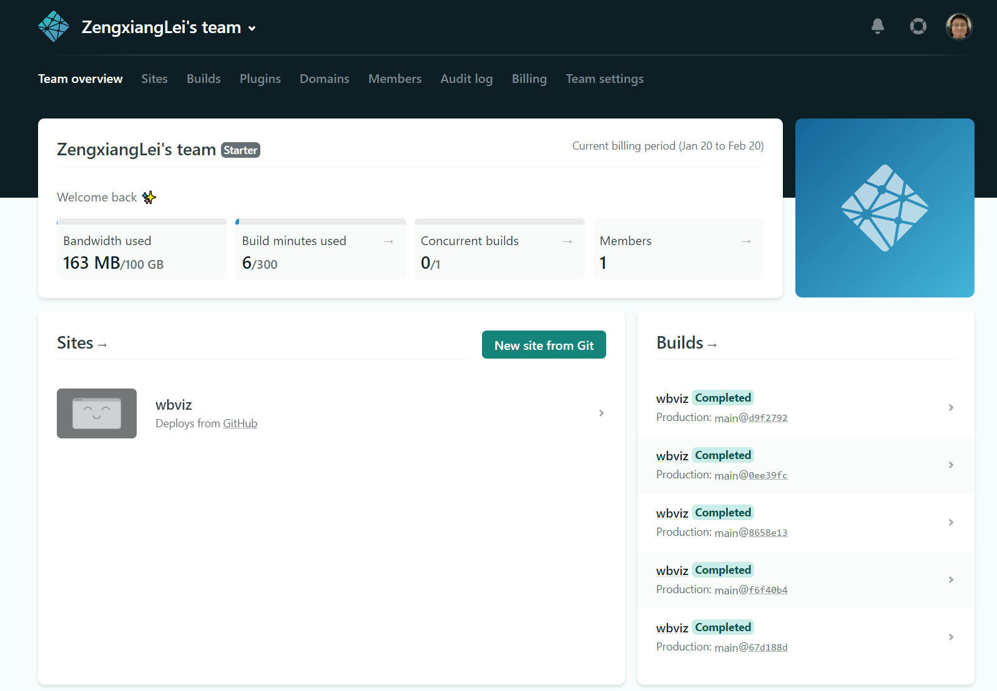
Netlify
Netlify is a powerful serverless platform with an intuitive git-based workflow.
Using netlify, you can create a website from your Git repository.

Slide 6
Netlify
Install netlify, “npm install netlify-cli -g”
(Optional) Login using “netlify login”
To deploy a project in netlify, run:
“netlify deploy”. It will pop up a browser for you to set the detailed parameters.
Check the website in the corresponding test link.
If the result is correct, then run “netlify deploy –prod” to deploy in the formal URL.
Extensions:
Change URL.

Slide 7
Where to go?
https://deck.gl/docs/api-reference
Try and publish your own visualization.

